Slide 1

“The Turtle Hunter”
Game

Slide 2
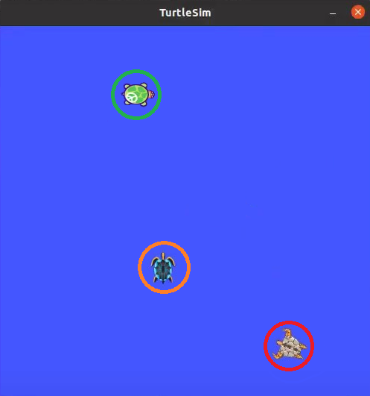

Idea
Prey-turtle
Player-turtle
Hunter-turtle
2

Slide 3
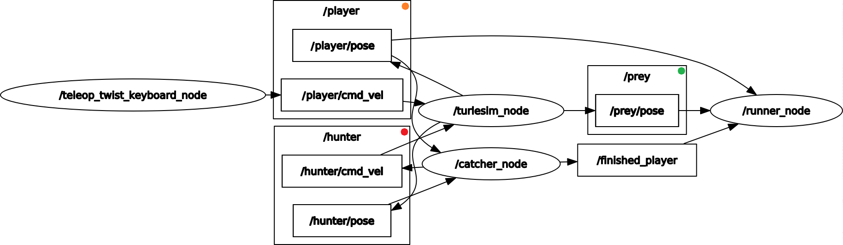
Approach
Randomly place preys
Kill the prey, if the player in its “area”
Create another prey when the previous was caught
Count the turtles killed by the player
Count the game time
Calculate the velocity
Publish the velocity to hunter
Kill player, if the hunter in its “area”
Close the game when the player was killed
Prey-turtle
Player-turtle
Hunter-turtle
3

Slide 4
Completed tasks
Randomly place preys
Kill the prey, if the player in its “area”
Create another prey when the previous was caught
Count the turtles killed by the player
Count the game time
Build the environment
Create prey-turtle
Calculate the velocity
Publish the velocity to hunter
Kill player, if the hunter in its “area”
Close the game when the player was killed
Kill the initial turtle
Delete turtle drawings
Create player turtle
Make a launch file
Randomly place preys
Kill it, if the player in its “area”
Create another prey when the previous was caught
Count killed turtles
Create hunter-turtle
Calculate the velocity
Publish the velocity to hunter
Kill player, if the hunter in its “area”
Close the game at the end
4

Slide 5
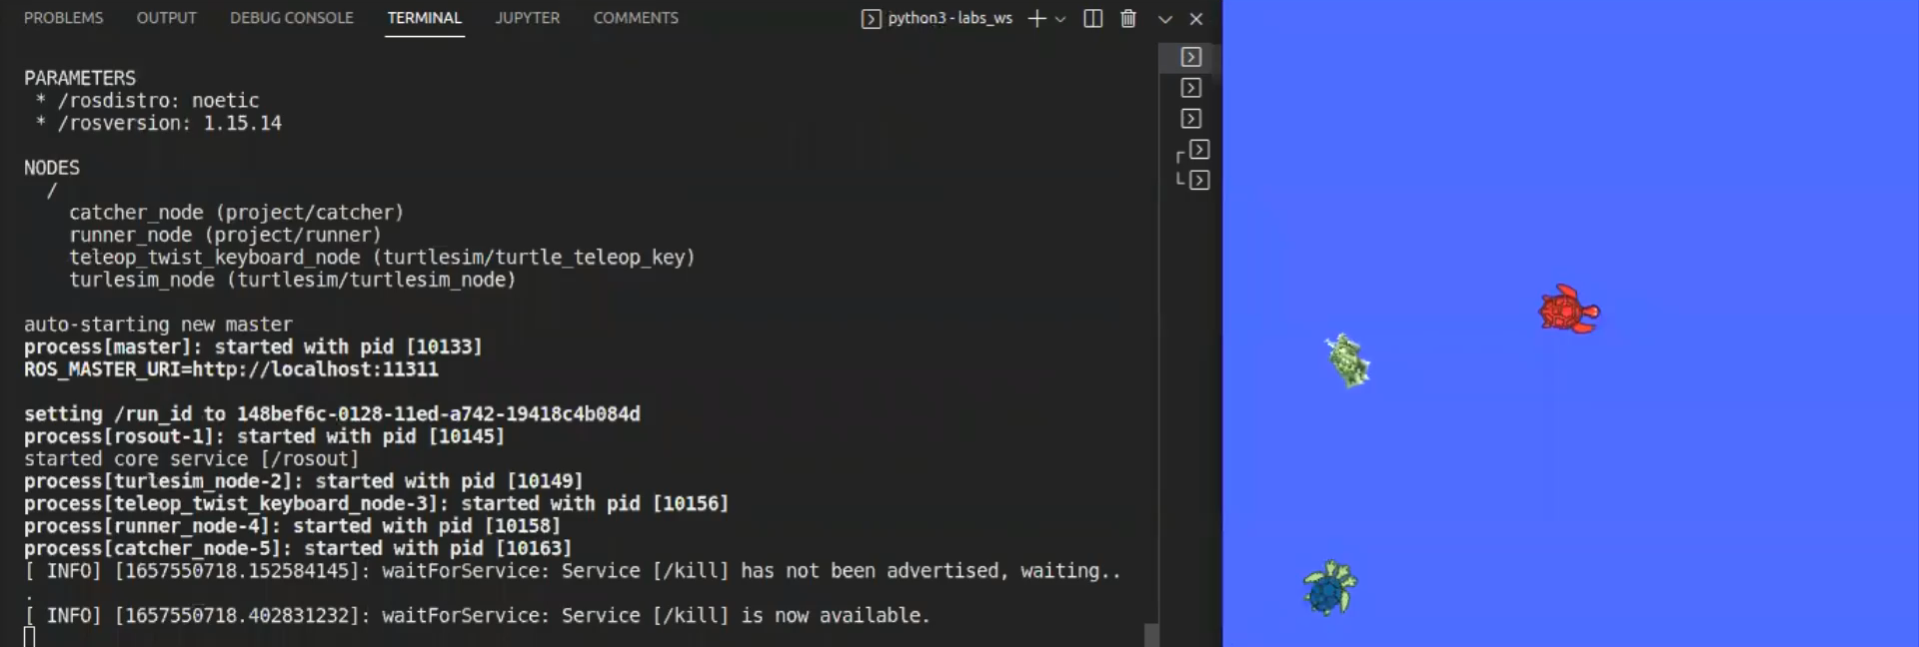
Video demonstration
5

Slide 6
Lessons learnt
Improved our skills in working with turtlesim;
Improved our skills in working with ros;
Learned how to create controller for the turtle;
Learned how to change the velocity depending on positions;
Learned how to terminate the process through launch file;
Learned how to change drawing parameters of the turtle (color, width, etc.);
Learned how to make system delay;
Learned how to randomize numbers in chosen interval;
Issues with spawning custom turtles without killing the initial one.
6

